Slide 1





TEAM CIRCUIT 25 PRESENTS,
SHAKTI KAVACH
IOT-POWERED SMART WEARABLE
FOR WOMEN’S SAFETY
Team Members:-
Kalash Bheda (Team Leader)
Heet Bharadwa
Arnav Bhandari
Jason Dsouza
Param Shah

Slide 2




PROBLEM STATEMENT – WOMEN’S SAFETY CONCERNS GLOBALLY
Develop an IoT-powered Smart Wearable for Women’s Safety that can detect distress situations and automatically alert emergency contacts or authorities.
01
02
03
🔴 THE HARSH REALITY
🌆 URBAN CHALLEnges
💡 THE NEED
1 in 3 women globally have experienced physical or sexual violence in their lifetime. (WHO, 2021)
In India alone, over 31,000 r*pe cases were reported in 2021. (NCRB Report)
45% of women in urban cities feel unsafe while commuting or walking alone at night. (Safety Trends Survey, 2022)
Slow emergency response times
Lack of real-time tracking
Absence of active alert
systems
Fear of raising an alarm in threatening situations
A smart, proactive, and discreet safety device
Real-time location sharing
Instant alert and defense mechanisms
Integration of health and wellness monitoring

Slide 3








OUR SOLUTION – SMART WEARABLE BAND FOR WOMEN’S SAFETY
👩‍💼 How It Works:
One-Touch Activation
Easy, one-touch emergency activation for immediate response.
Laser Deterrent
Laser light deterrent system to stun off potential threats.
Audio Alarm Buzzer & Esp32 Cam Module
High-decibel audio alarm to attract attention in emergencies and starts the recording and live coverage of the happening
Pepper Spray
Precision pepper spray deployment for effective self-defense.(using servo motor
Emergency Help Call & SMS
Once the system is triggered the nearby police authority gets the call and SMS for help ! (so even if there is no network still the authority get the message via SMS)
Exact Current Location
After the call simultaneously the system send the location of the women(victim) to the police and her gardians via mail

Slide 4









BUILT-IN HEALTH & WELLNESS FEATURES
Menstrual Tracking
Heart Rate
Track menstrual cycles for better health management.
Monitor heart rate for insights into cardiovascular health.
Sleep Detection and Steps Count
Stress Detection
Detect stress levels to promote mental wellness.
Detect sleep records to promote mental wellness.

Slide 5
🌍SOLUTION ALIGNED WITH UNITED NATIONS SDGS:
The device contributes to several of the 17 Sustainable Development Goals (SDGs):
🟢 SDG 3 – Good Health & Well-being
our wearable tracks health parameters like heart rate, SpO2, stress, sleep, and menstrual cycle, directly supporting health monitoring and early alerts in emergencies.
🟣 SDG 5 – Gender Equality
The primary goal of our project is to empower women and enhance safety and freedom in public spaces, aligning directly with Target 5.2: Eliminate all forms of violence against women and girls.
🟠 SDG 9 – Industry, Innovation, and Infrastructure
Using IoT, smart sensors, and wearable tech to solve a societal issue showcases innovation and smart infrastructure development.
🔵 SDG 11 – Sustainable Cities and Communities
By making urban environments safer and more responsive, especially for women, you contribute to inclusive and safe communities.
🔴 SDG 16 – Peace, Justice, and Strong Institutions
Connecting the band with law enforcement contributes to justice and safety frameworks, supporting Target 16.1: Significantly reduce all forms of violence.
🎯 Optional Bonus SDG (If we Expand in the Future):
SDG 17 – Partnerships for the Goals: If you plan to collaborate with government bodies, NGOs, or police departments, this goal can also be added in your future scope slide.

Slide 6



KEY FEATURES & USPS
🛡️ Safety First:
Quick Response Emergency Button
Integrated Laser & Pepper Spray
GPS-Based Alert System to nearest Authorities & Guardians
💓 All-in-One Wellness Tracker:
Health metrics + Period Tracker in one band
gives all over safety ( Health + physical )
📱 Smart & Discreet:
Compact design, mobile app synced
Works without needing to unlock a phone
🚀 USP:
First of its kind combining defense, health tracking & emergency contact system

Slide 7



FUTURE ENHANCEMENTS
“Empowering women with smart tech – blending safety, health, and AI-driven innovation.”
🤖 AI HEALTH FEEDBACK SYSTEM
🛑 PREVENTING FALSE ALERTS
🔄 CONTINUOUS IMPROVEMENTS
Personalized health insights
Emotional & stress monitoring
5-second grace window to cancel alert via a double-tap
Voice-command based cancellation using user-authenticated keyword
Adding live and more accurate gps tracking
Community alert network for nearby women

Slide 8
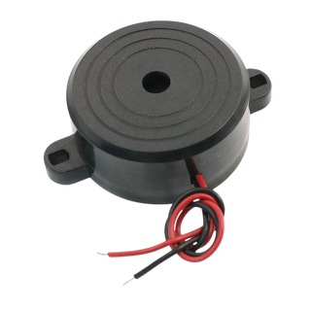
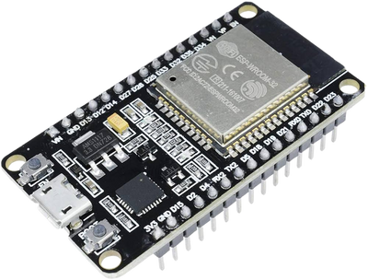
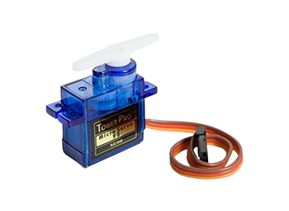
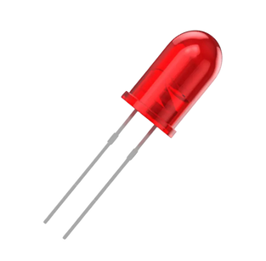
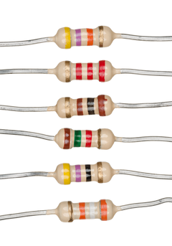
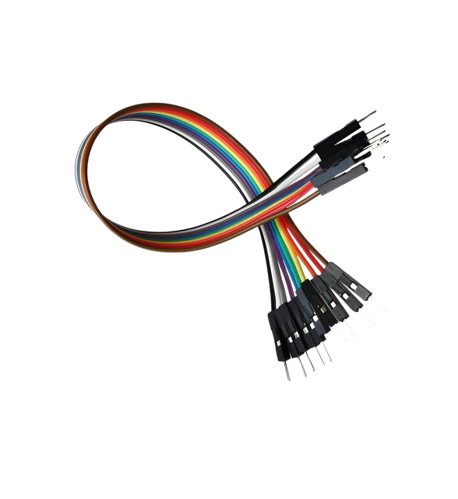
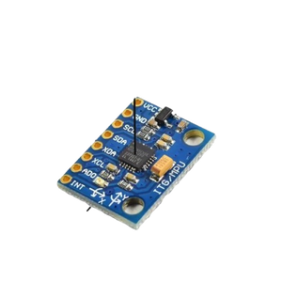
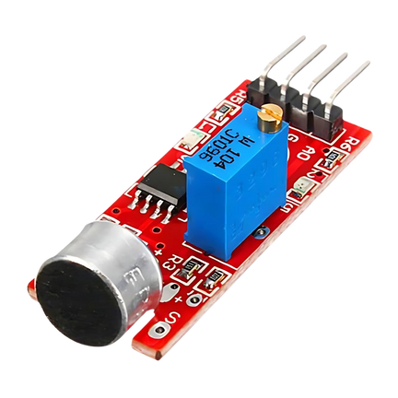
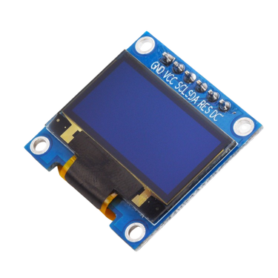
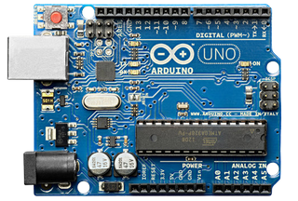
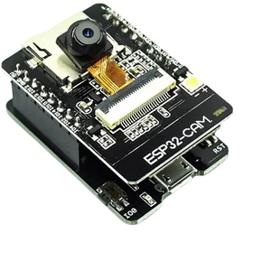
COMPONENTS USED IN THE PROJECT
Esp32 Microcontroller
Active Buzzer
Led
Servo Motor
Esp32 Cam Module
Pulse Sensor (GYMAX-30100)
Accelorometer & Gyroscope(MPU6050)
OLED Display
Microphone(KY-038)
Arduino Microcontroller
Resistors and Jumper Wires

Slide 9
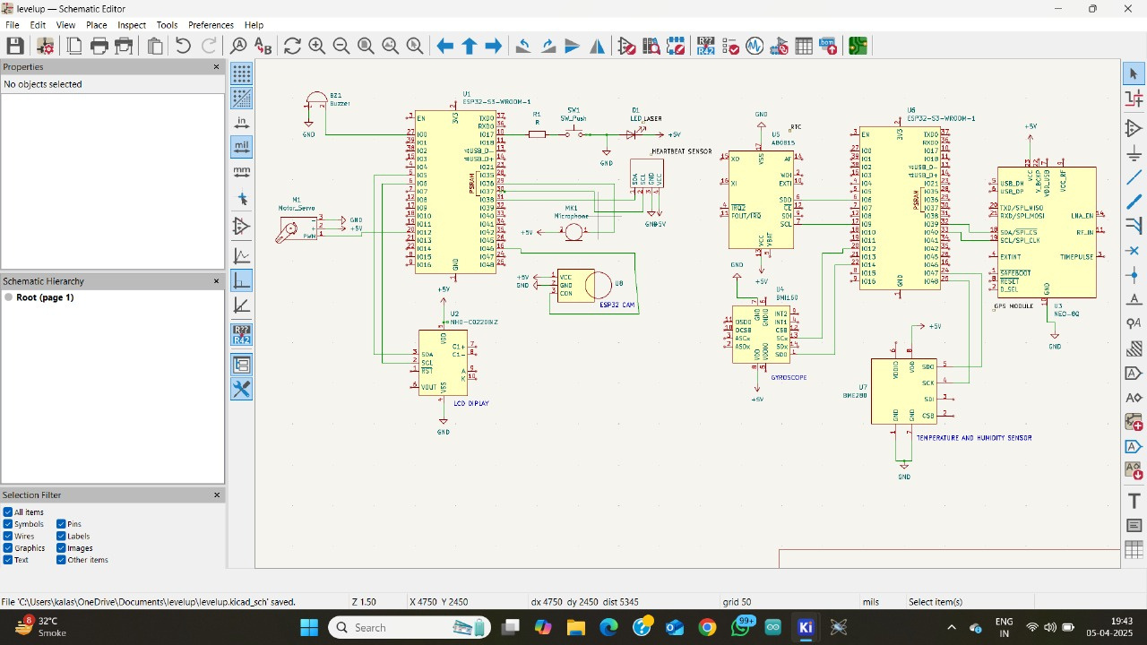
Schematic diagram of iot based Women safety wearable

Slide 10
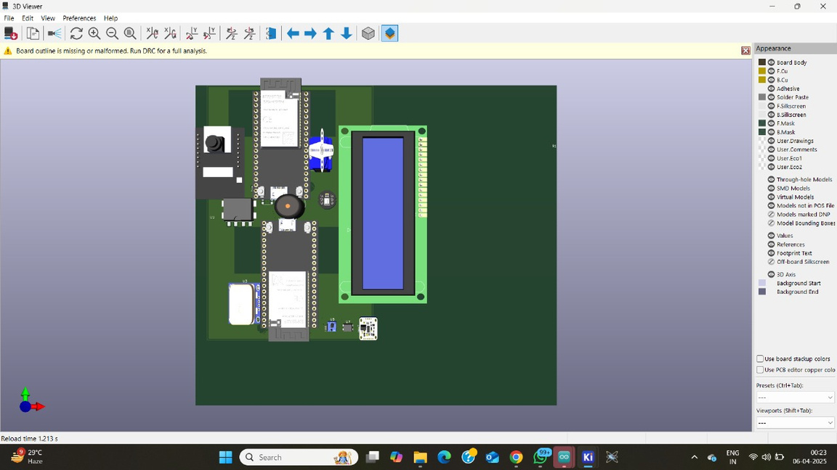
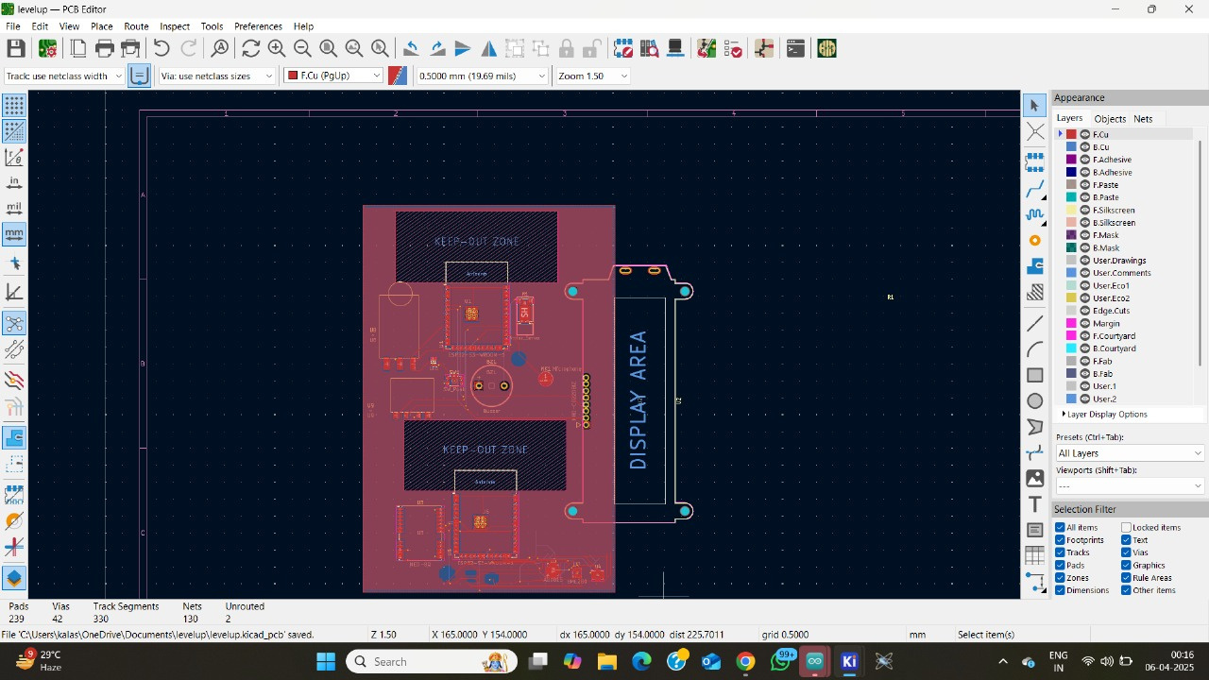
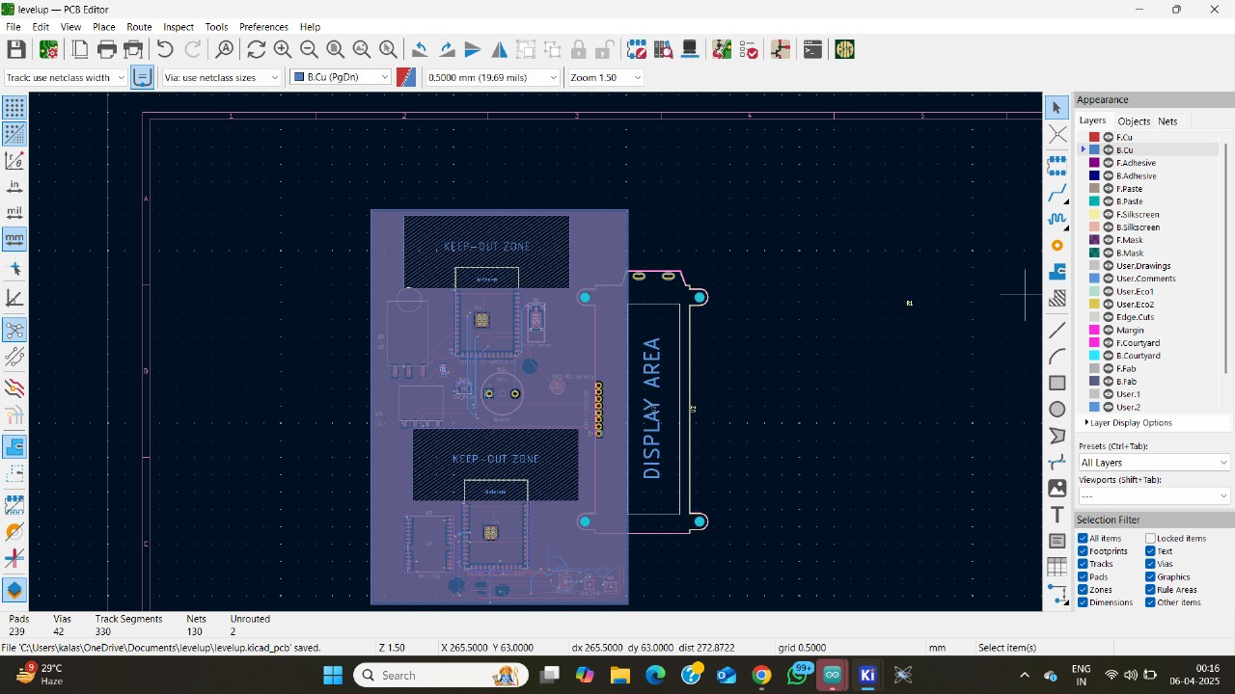
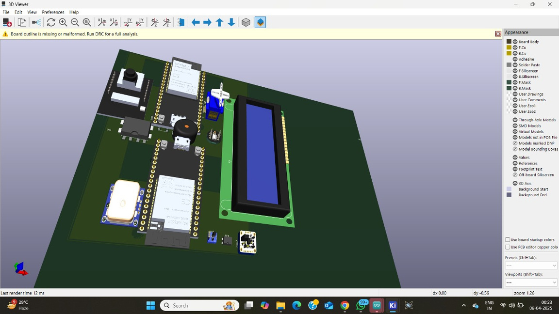
PCB Design:-
3D Model :-
Front Copper view
Back Copper view

Slide 11
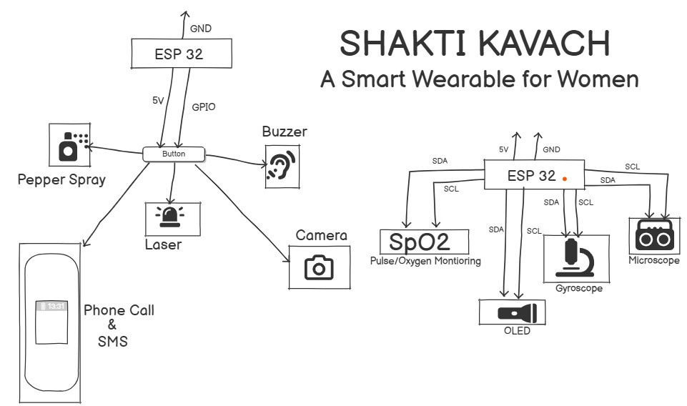
BLOCK DIAGRAM / FLOWCHART

Slide 12
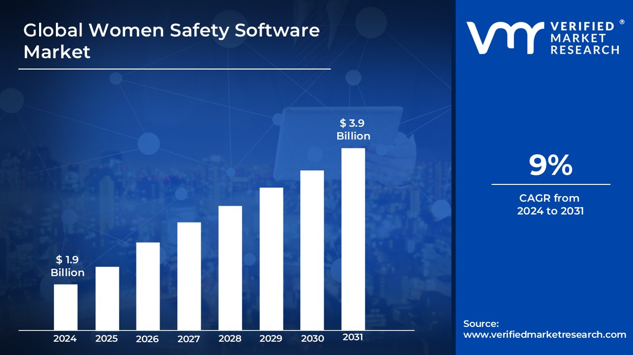
MARKET OPPORTUNITY & COMPETITOR ANALYSIS
📊 Market Size:
9%
$1.9B
Market Growth
Estimated Revenue
Projected to reach $3.9 by 2030 (CAGR: 9%)
Global Wearable Safety Devices Market: $1.9B (2024)
🏢 Existing Competitors:
SafetiPin, Leaf Wearables (Safer), MySafetipin, Revolar
Limited functionality – mainly GPS tracking & alerting
💥 Our Edge:
Self-Defense + Health Monitoring + AI Wellness Integration

Slide 13

VISION AND IMPACT:
Empowering Women
Creating Safety
Empowering women through innovative technology solutions.
Creating a safer environment for women in urban and rural settings.
Expanding Solutions
Continuously expanding personal safety offerings.
Our vision is to create a world where women feel safe and empowered, with SHAKTI KAVACH leading the way.

Slide 14
CONCLUSION AND KEY TAKEAWAYS
🧠 Final Thoughts:
Women’s safety isn’t just a product — it’s a responsibility.
🎯 Key Takeaways:
Combines Defense + Alert + Health tracking
Real-time connectivity to authorities & guardians
Future-ready with AI enhancements & feedback systems
Scalable solution with real-world impact potential

Slide 15
THANK YOU
-Team CIRCUIT 25

